Slide 1


MEDASSIST AI:
AI Medical Symptom Analysis & Disease Prediction System
Milestone 4 Progress
Name: Amrutha M
Branch: CSE - AIML
Internship: Infosys Virtual Internship 7.0

Slide 2
Objective
The main objective was to:
validate the AI performance
optimize responsiveness
Deploy to the cloud
End-to-end demonstration

Slide 3
The overall workflow:
Patient → Symptoms → ML Prediction → Risk Assessment → Recommendations → Report
Healthcare Provider → Patients → Predictions → Reports → Analytics

Slide 4
Cloud Deployment
Deployed the Dockerized FastAPI backend on Railway.
Deployed the React frontend on Vercel.
Connected the Vercel frontend to the Railway backend using the deployed API URL.
Updated frontend API requests from the local server to the cloud backend.
Configured CORS to allow communication between the frontend and backend.
Tested registration and login on the deployed application successfully.

Slide 5
Link to access the project online
https://frontend-beta-nine-38.vercel.app/?utm_source=chatgpt.com

Slide 6

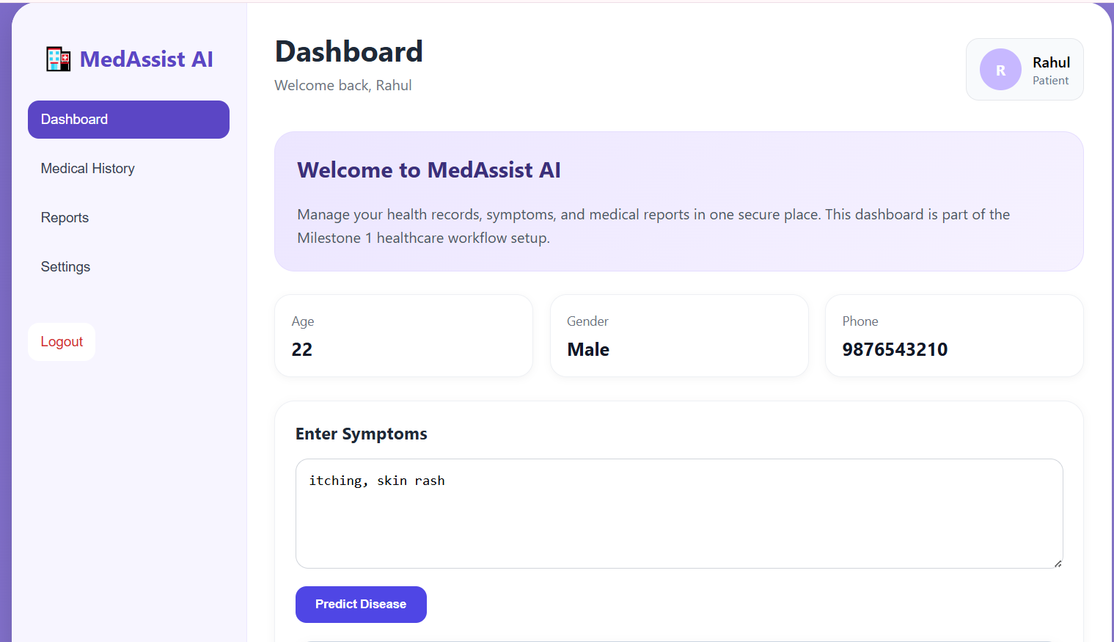
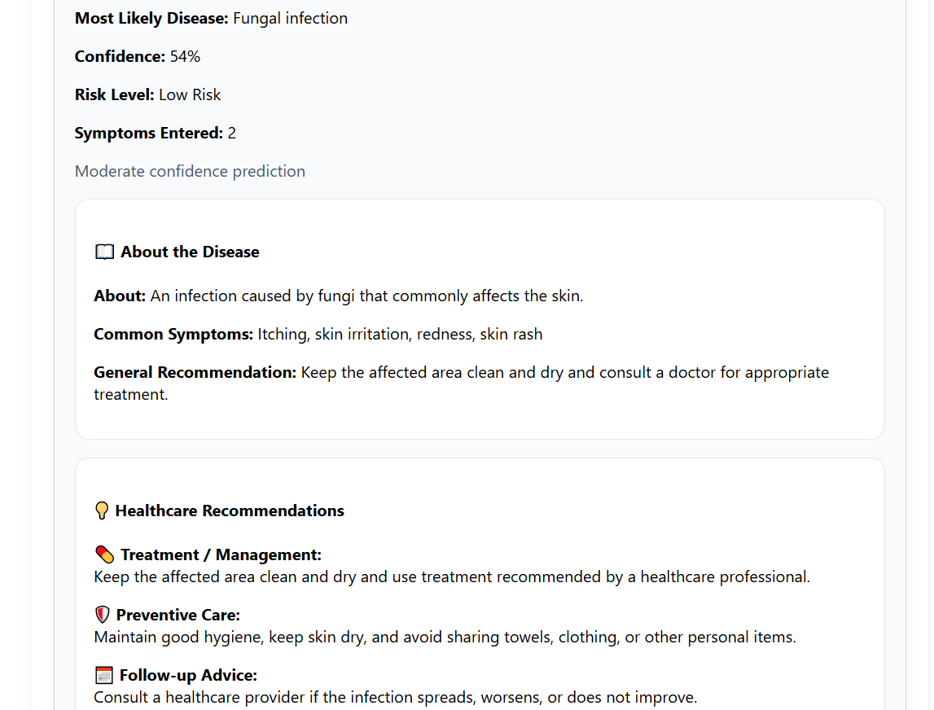
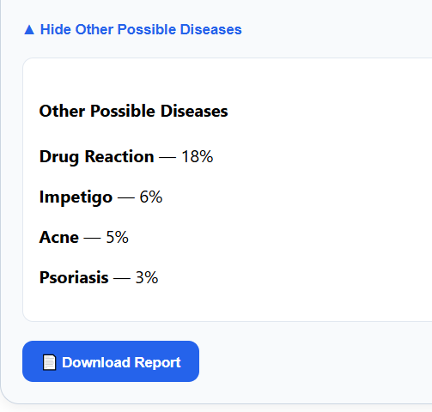

Patient Dashboard
3

Slide 7
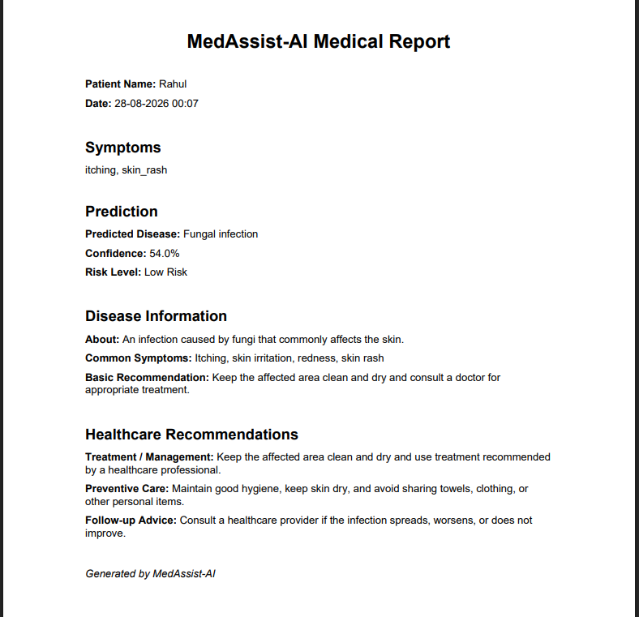
Downloaded Report

Slide 8
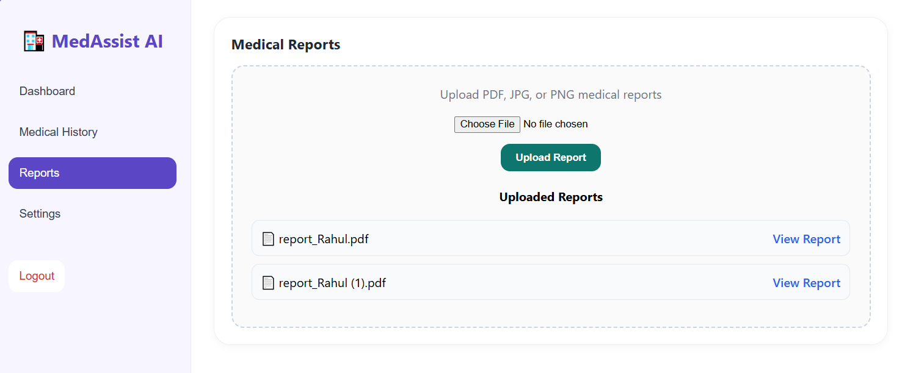
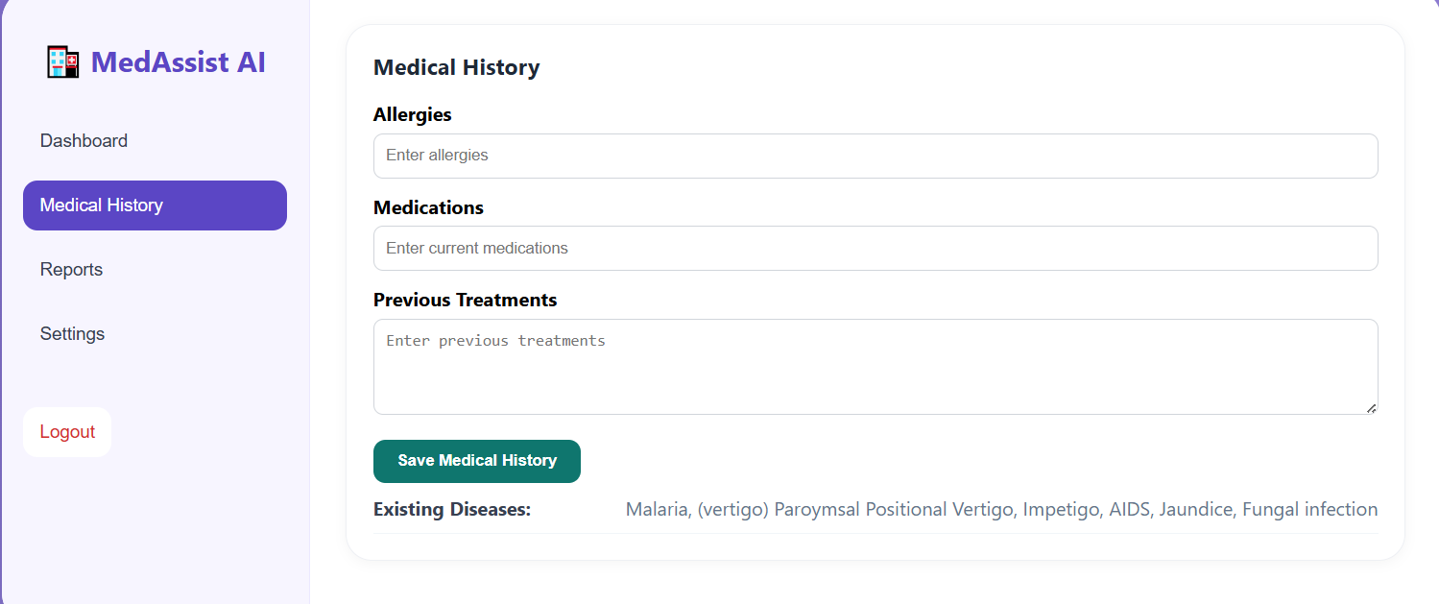
The report can be uploaded as well as viewed
The predicted diseases is shown in the medical history

Slide 9
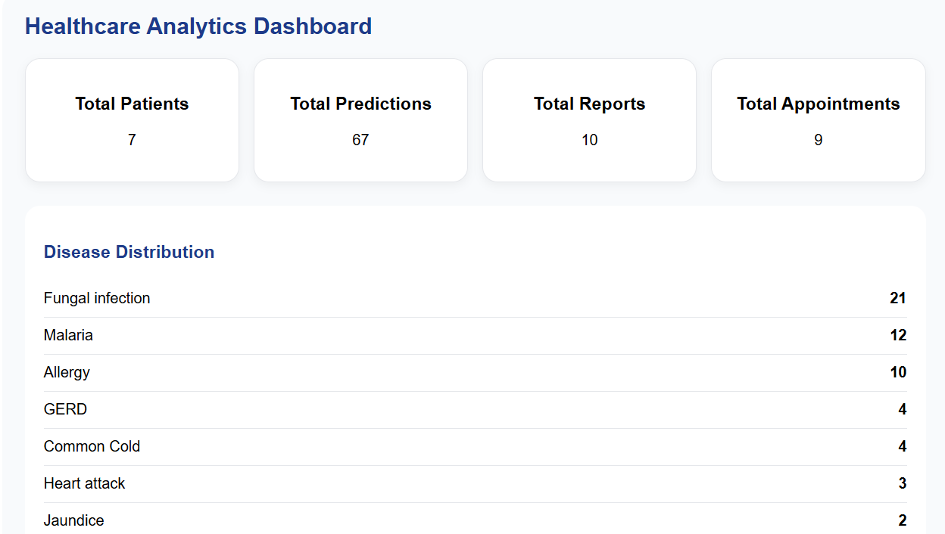
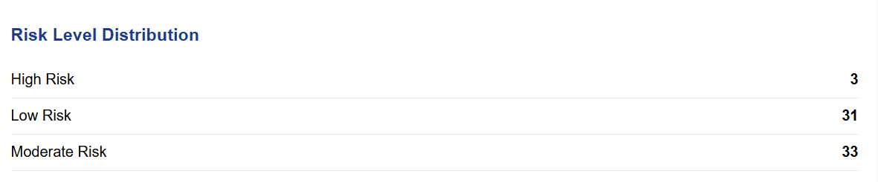
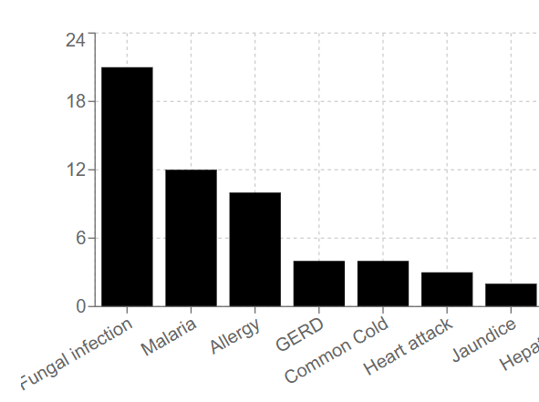
Healthcare Provider Dashboard

Slide 10
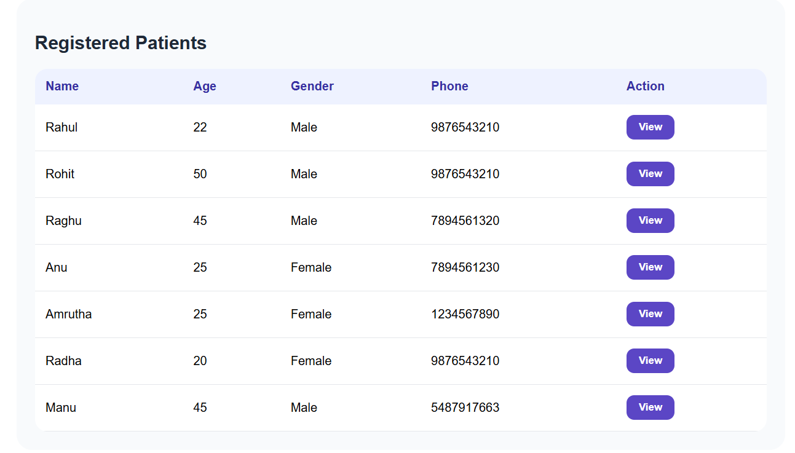
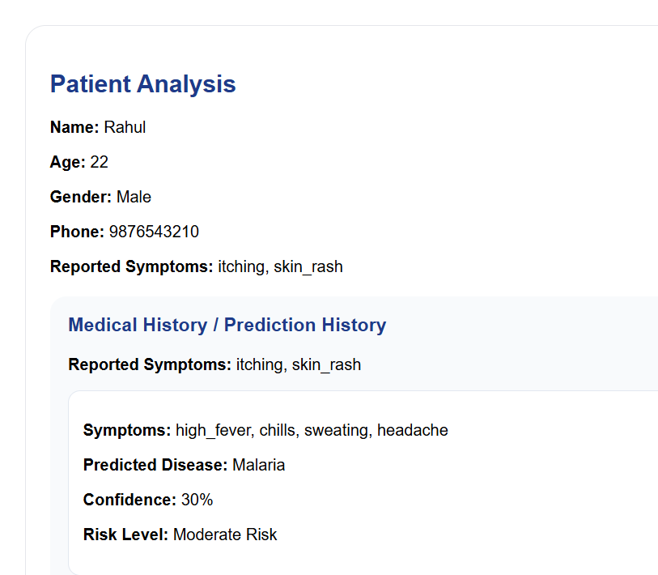

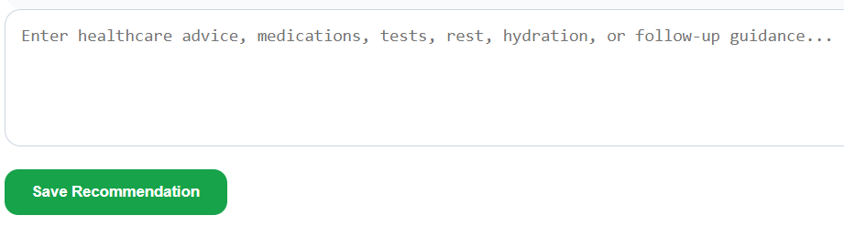

Slide 11
THANK YOU

